Slide 1
Title: Loan Management Dashboard Overview Subtitle: Data Insights, Cleaning, and Visualization Presented by: Harsh Jethva Date: 06/07/2025

Slide 2
Objective
To analyze and present insights from the loan management data
Focus on performance, collection, and loan statuses
Share findings using visual dashboards

Slide 3
Data Cleaning & Handling with python
Removed missing/null values from fields like BranchName, Loan Status, Collection Amount
Standardized formats for:
Dates
Currency (₹842M, ₹100M, etc.)
Removed duplicate records and ensured consistency
Merged datasets for branch-level and state-level summarie

Slide 4
Key Summary Metrics
Metric | Value
Avg. of DPD | 12.31
Total Closing Balance | 14K
Total Joining | 1,241
Total Exit | 1,334
Active Loans | 244.6K
Overall Collection | ₹842M
Closed Loan Count | 5,976

Slide 5
Why We Created the Dashboard:
To centralize and visualize critical business KPIs across loan operations.
To enable quick, data-driven decision-making for management.
To track performance across branches,Loans, and states in real-time.
To identify collection trends, risk patterns, and workforce dynamics.
To improve transparency and accountability at every operational level.

Slide 6
Why We Collected These Insights:
To analyze loan growth, closures, and overdue collections across regions.
To understand employee movement trends like joining, exit, and promotions.
To detect top-performing branches and underperforming areas.
To uncover which loan products drive most of the business volume.
To support strategic planning, portfolio management, and compliance checks.

Slide 7
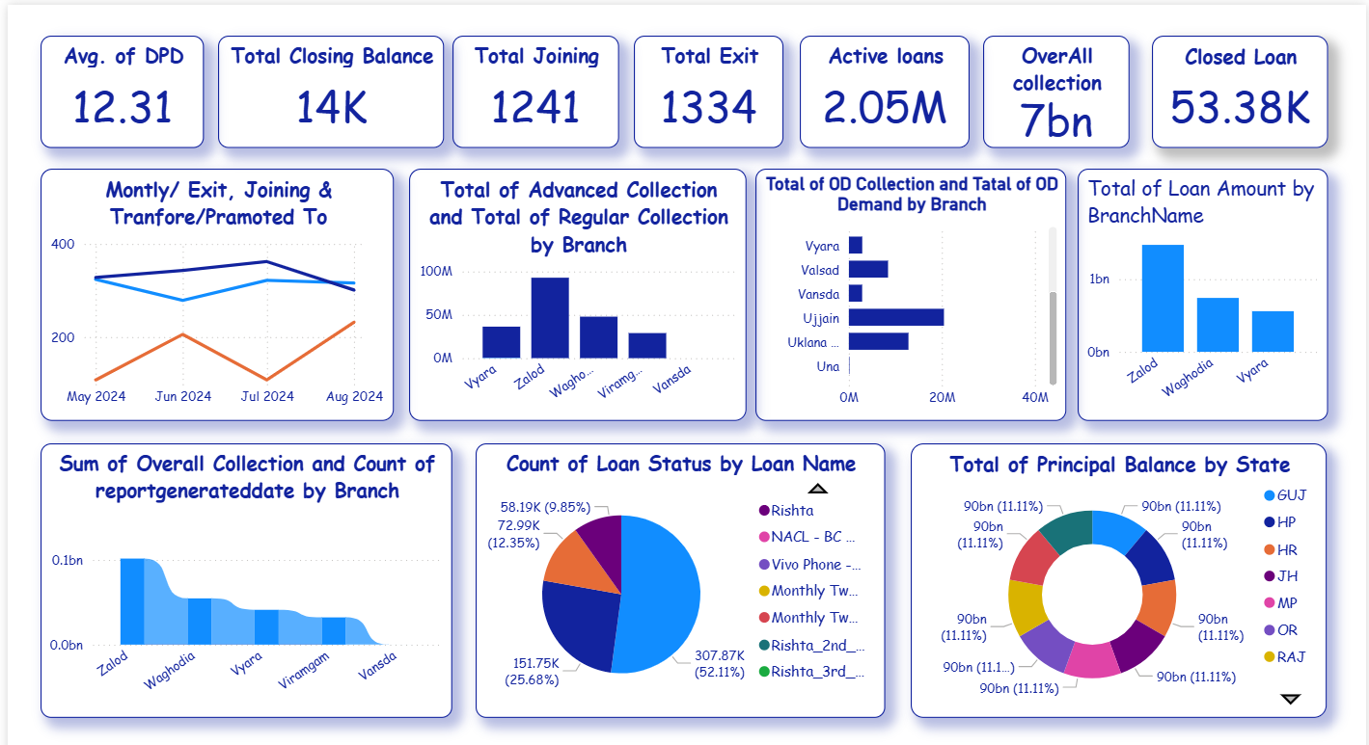
Dashboard

Slide 8
Thank You

